Slide 1
Business Owner Life-Stage Design (BOLD)
Executive compensation opportunities:
Recruit, Retain, Reward!
Insurance products issued by Minnesota Life Insurance Company | Securian Life Insurance Company

Slide 2
What is BOLD?
Notes:
Let’s start by discussing: what is BOLD?

Slide 3
What is BOLD?
Ready-to-use marketing program for your business owner clients
Turn-key fact-finding to help you to identify business owner priorities and financial solutions
Educational content for:
    Business owner clients
    Business owner professionals
    Financial professionals
Notes:
With Business Owner Life-stage Design (BOLD), you have the tools, support and resources you need to advise your business-owner clients. BOLD helps you identify strategies and solutions that address the unique and complex challenges they face – helping enable them to achieve both the short and long-term goals that matter most.
Every day, business owners face a multitude of complex financial and business decisions, including:
How they will fund retirement
When and if they will step-back from the business
Tax considerations and issues
Long-term care costs
Wealth transfer to the next generation
Provide benefits to retain their top employees
Prepare for potential loss of a key employee
Determine how they will exit their business
The sheer number of decisions can paralyze a business owner into non-action. At Securian Financial, we understand these challenges and that business owner clients are looking for guidance and direction. That’s why we developed a program that gives you the power to provide potential solutions for almost any business owner need.
Marketing program - Offer a BOLD seminar and business valuation
In many cases, a business owner’s most valuable asset is their business. Knowing the value of that asset is critical to proper business planning and achieving personal financial goals.
Offering a complimentary, no obligation business valuation will help you ensure attendance at your BOLD seminar.
Visit the literature center and order:
• BOLD consumer brochure (F79732-8)
• BOLD initial fact finder (F79732)
Download the BOLD seminar invite (F79732-20) and client seminar.
Our advanced sales team can help you deliver an efficient business valuation to help your clients move their plans forward.
Turn-Key Fact-Finding
Identifying stakeholders - The process begins with your first interaction with your client or prospect. Use the initial BOLD questionnaire (F79732) to discuss and review the following:
What parties are involved?
All small business owners have both business and personal stakeholders. They must balance family needs and desires with those of their business and their employees.
Start by identifying their stakeholders — and how they may be impacted throughout the BOLD process.
Determining goals and priorities
Continue using the initial BOLD questionnaire to guide your discussion, by walking the client through the questions and ranking their priorities.
Once you’ve gathered information and have an idea of your client’s most important goals and priorities, it’s time to prioritize their concerns — and start providing solutions.
Educational content
BOLD also provides you with resources to guide your understanding of key business concepts and facilitate your strategy discussions with clients:
Business profiles — Describe sales opportunities, identify target clients and demonstrate how each opportunity works
Consumer flyers — Address business-owner challenges and offer potential solutions
Strategy-specific guides — Financial professional resources regarding business succession and executive compensation
Forewords to counsel — In-depth technical document to share with your client’s legal team

Slide 4
Notes:
Here is the BOLD Solution diagram.
This is simple way to explain how you (the financial professional) can help the business owner. This diagram is on the cover of the BOLD initial questionnaire
The script – how to introduce BOLD to business owner clients (example of discussing this in front of clients)
“BOLD, or Business Owner Life-stage Design, is a system for providing financial solutions to help you grow your business.”
“The BOLD strategy starts today and ends when you exit your business.”
“As a business owner, you face many financial decisions. In addition to growing your business now, you must also think about whether you will step back one day or retire altogether [point to Retirement/Stepping back], and protect yourself in the event of chronic illness as well.” [point to Long term care]
“At the same time, you want to provide some kind of retirement plan for the people who work for you. [point to Retirement plans] And some of those employees are probably critical to the ongoing success of your business. You also want to make sure you reward them as an incentive not to leave you for your competitor [point to Executive compensation], and help protect your business from their premature death.” [point to Key person protection]
“Eventually, you will hand over the business you’ve built to someone else [point to Business succession], and make plans for passing your accumulated wealth to your heirs.” [point to Estate planning]
“This sheer number of decisions and their complexity can paralyze a business owner. However, ignoring these issues won’t make them go away. You need answers to questions critical in the decision-making process.”
“If we decide to work together, we can determine which of these concerns is most important to you in just one visit. As we create a solution, we can address your other concerns. Eventually we will have strategies in place to help protect…
…you, [point to “You”]
…your family, [point to “Your family”]
…your employees, [point to “Your employees”]
…and your business.” [point to “Your business”]

Slide 5
Designing the right executive compensation program
Notes:
The focus of this presentation is on the executive compensation solutions
Businesses across industries — both small and large — want to recruit and retain top executives who are instrumental in growing the company. With Business Owner Life-stage Design (BOLD), you have an opportunity to help business owners create compensation packages that encourage these individuals to remain with the company.

Slide 6
What is an executive compensation strategy?
Mutual agreement between the business and the key employee
Recruit, retain, and reward key employees
Notes:
First of all, let’s discuss what is an executive compensation strategy?
It’s an agreement between the business and the key employee. Without mutual agreement, an executive compensation solution is impossible. This makes determining a strategy that works for both parties an important part of the process.
An executive compensation strategy that employs life insurance can reward and incent key employees by maximizing a business owner’s dollars. And offer even more options for businesses, compared to cash bonuses.
This presentation is designed to help you understand the many types of executive compensation strategies available, so you can offer the right solution for your business owner clients — no matter their life stage.
Three Rs: recruit, retain, and reward
Now let’s discuss what the business and the key employees are looking for:

Slide 7
Employers want to keep exceptional employees:
Increased productivity and profitability
More growth in the value of the business
Cost to replace key employee
Help ensure continued sales/revenue directly related to key employee expertise
Position the business for a profitable sale in the future
Notes:
What are employers concerned about?
[Read slide – think about adding in a story or two from the business owner perspective for one or two of the points on the slide]
Business owners are thinking:
How can I keep this employee?
Is there another way to benefit this employee beyond qualified plans?
Can I put golden handcuffs on this benefit for this employee?
How might this employee eventually take over this business?

Slide 8
Exceptional employees are looking for:
Financial security for themselves and their families
Future retirement income
Potential future growth opportunities
Notes:
What are employers concerned about?
[Read slide – think about adding in a story or two from the executive’s perspective for one or two of the points on the slide]
Exceptional employees are thinking:
Why should I stay here?
I’ve maxed out my qualified plan; how else can I put money away for retirement?
How can I protect my family from the unexpected?

Slide 9
Identifying executive compensation opportunities
Notes:
How to identify executive compensation opportunities
You want to engage financially strong and well-established companies. While emerging companies may need to reward their executives, they may not be in a financial position to justify the cost of these programs.
Look for companies with three or more “top hat” executives. Keep in mind Securian Financial can design solutions for as few as one individual. With our executive benefit options, combined with our group life insurance and retirement solutions, we can accommodate all the needs of your business owner clients.
Who is an employee for an executive compensation strategy?
It will depend on the strategy. Generally there may be a small group of high-ranking employees who are key management or earn substantially more than other management, sometimes considered “top hat” executives. The U.S. Department of Labor considers top hat executives as those who are so valuable to the company that they have the ability to negotiate their compensation packages. These individuals have likely risen to their position because they’re highly talented and have driven the company forward in some way.
Chief Executive Officer
Chief Financial Officer
Chief Marketing Officer
President
Executive or Senior Vice President
Vice President of Sales
Make sure you involve all key decision-makers from the beginning, and possibly meet with key individuals separately throughout the process:
Company ownership
Accountant
Legal team

Slide 10
Why use life insurance?
Notes:
This presentation focuses on using life insurance in executive compensation strategies.

Slide 11
Three components of life insurance
Death benefit
  May provide protection for the executive’s family in case of the unexpected
  May provide key person coverage for the business
  May provide cost recovery for the business
Notes:
Life insurance is a unique financial tool in executive compensation space.
There are two parts to a permanent life insurance policy: death benefit and cash value.
Let’s start by discussing death benefit. There are a number of considerations when looking at the death benefit of a life insurance policy and where it can fit.
First, the policy can be used to provide protection for the executive’s family in case an unexpected death occurs. It may be this benefit when the family may need it the most.
In addition, if the policy is owned by the business, the death benefit can be used for key person coverage. Finally, in some executive compensation strategies, the death benefit can be used for cost recovery for the benefit provided.

Slide 12
Three components of life insurance
Cash value
  Used as supplement retirement income source
  Provide a source to assist in purchasing the business from the business owner
  Used as an informal funding for retirement benefit
  General asset of the business
Notes:
The cash value component can also be an important component of the strategy
If the policy is owned by the executive, it may provide an income tax free supplemental retirement income source. In addition, it can also be a source (for example, a down payment) to assist the key executive to purchase business from the business owner.
If the policy is owned by the business, it may provide an informal funding source for a retirement benefit. In addition, it is a general asset of the business.

Slide 13
Three components of life insurance
3. Riders
  Optional with separate charges
  Chronic illness coverage rider
Notes:
Riders on a life insurance policy can also add additional value. These are optional and typically have a separate charge.
An example of a rider is chronic illness- one that can provide protection for the executive’s family if a long-term care/chronic illness event happens.

Slide 14
Take BOLD action – identify your client’s executive compensation goals
Notes:
Now, let’s discuss how to identify which executive compensation strategy fits within your client’s goals.

Slide 15
Two BOLD Questionnaires
Initial questionnaire
    General questionnaire
    Focus on the business owner and their family
Executive compensation questionnaire
    Specific questionnaire for executive compensation
    Uncovers the desires of both business owner and executive
Notes:
Once you’ve identified and engaged a company, use our BOLD initial questionnaire (F79732) and executive compensation questionnaire (F79732-3) to help uncover the desires of both the business owner and executive to find an appropriate compensation solution.
The initial questionnaire is the general one focusing on the business owner and their family.
The executive compensation questionnaire is specific one which uncovers the desires of both business owners and the executive.

Slide 16
Executive compensation questionnaire – Part one
Notes:
Part One of the questionnaire is to get the personal information for the executive.
An alternative is to put this information together in a census spreadsheet if the business owner wants to have the same benefit for a group of key employees.

Slide 17
Executive compensation questionnaire – Part two
Notes:
Part two starts with the directional question of - Which is more valuable to the executive?
Three choices:
Death benefit
Financial protection for family members can also be perceived as a valuable benefit. Compared to the outright purchase of permanent life insurance protection, death benefit protection in an executive compensation package can be far more affordable. A life insurance death benefit can also be useful for recovering executive compensation program costs, so benefit programs often center around the decision on who receives the death benefit:
The executive’s dependents?
The company?
Both?
2. Retirement income
Aside from current income, a primary motivation for any employee is more income for retirement. Executive compensation strategies often focus on providing additional retirement income. This appeals to executives because:
They’re often at or near contribution limits for their qualified retirement plans.
They have no real need for additional current income.
They see benefit in the opportunity to put more money away for retirement.
3. Long-term care
For some executives, long-term care coverage may be an attractive option. If this is an aspect important to the executive, adding a chronic-illness rider may be an option, or exploring a Life-LTC hybrid product, such as our SecureCare III.
The next directional question goes deeper in the selected choices:
Death benefit protection
The main purpose and advantage for using permanent, cash value life insurance is the death benefit. Some executive compensation strategies provide the death benefit to the executive, some to the employer, and others share the death benefit between the two parties.
Death benefit solely for the executive’s beneficiaries
In these situations, the death benefit is not needed by the employer. Overall, the death benefit is part of the benefit provided by the company, in addition to potential supplemental retirement income from the policy’s cash value.
Death benefit solely for the employer
In key person strategies, the company protects itself should the executive die. Upon a key person’s death, the death benefit can help cover lost sales, lower earnings or added costs for hiring and training a replacement. In situations where the employer retention strategy calls for only supplemental employee retirement income, an employer may wish to recover the costs of its program through the policy death benefit.
Death benefit shared between employer and key employee’s beneficiaries
In split-dollar arrangements and some salary continuation strategies, the two parties may “split” or share the death benefit. The death benefit provides cost recovery for the employer, as well as additional incentive for the executive to remain with the company.
Retirement income
The decision regarding retirement income requires the business owner to balance the timing of a potential tax deduction, versus the tax ramifications of the key employee receiving the income. Quite simply, the business owner will receive a tax deduction when the benefit is paid, and the executive will be taxed on the benefit at that time.

Slide 18
Executive compensation questionnaire – Part three
Notes:
The final set of three directional questions further focus the business owner’s objectives.
The dollars to fund this strategy should come from (or who pays):
Another factor for determining the appropriate executive compensation strategy is who will provide the funding. In most cases, the business will fund the arrangement, since it wishes to reward and retain the executive.
In a pure salary deferral NQDC strategy, the executive defers a bonus or a portion of salary into retirement, at which point the executive may be in a lower tax bracket. In other strategies, the employer may also want to match a percentage of the executive’s deferral.
When discussing who will fund the strategy, keep in mind:
Employee contributions are typically after-tax dollars (except NQDC salary deferral and employer match)
Business dollars have cost recovery potential with NQDC and split-dollar strategies
Which will better serve your key executive retention efforts?
“Golden handcuffs” are incentives an employer can offer key people to encourage their loyalty to the company. They contain stipulations spelling out benchmarks or timetables that must be achieved in order to gain access to the benefit. Depending on the industry, the economy and current job market, golden handcuffs may not be necessary. Often, an executive bonus may be enough to keep them. However, it’s important to periodically review the strategies and their effectiveness.
Is it important for the business to recover some or all of the program costs in the future?
Whenever possible, a business will want to recover its costs. Depending on how important this is for the business owner, explore options for cost recovery and determine which strategies best suit their needs.

Slide 19
Executive Bonus arrangements
Executive Bonus
Golden Executive Bonus Arrangements (GEBA)
Golden Executive Match (GEM)
Notes:
Let’s start with Executive Bonus arrangements

Slide 20
Executive Bonus Arrangements
Simple (to understand) and deductible (to the business)
Employee owns the life insurance policy
Employer bonuses premium dollars to employee
Notes:
For all of the executive bonus arrangements:
The owner of the life insurance policy is the employee
The insured of the policy is the employee
The beneficiary of the policy is whoever the employee lists

Slide 21
Executive Bonus
Notes:
Let’s go deeper into each of the three types of executive bonus arrangements (executive bonus, GEBA, GEM).
The Executive Bonus is the first one.
The opportunity:
Business owners wishing to:
Reward and retain their key people with a simple, tax-deductible strategy
Provide key employees with an incentive that helps drive business profitability and growth
The solution:
An executive bonus arrangement provides a bonus to reward and retain essential employees. The bonus is paid as a premium on a life insurance policy. The key employee is the owner and names a beneficiary of the life insurance policy.
Target Clients
• Single or multiple business owners
• Has a key employee
• Key employee provides expertise in client relationships, industry knowledge, sales or management
How it works:
• Employer pays a tax-deductible bonus to the employee
• Employee pays income taxes on the bonus amount. The employer may choose to pay the income taxes for the employee as an additional bonus
• Employee takes out a personal life insurance policy and names a beneficiary
• The bonus is used to pay the premium on the life insurance policy to Minnesota Life Insurance Company or Securian Life Insurance Company, a New York authorized insurer
• Since the employee owns the policy, he or she may take money from the policy’s cash value on a tax-advantaged basis
• If the employee dies, the death benefits are payable to the beneficiary
Employer benefits:
• Little to no administration
• Simple and flexible
• Immediate income tax deduction
• Selective participation
• Not subject to employer-owned life insurance (EOLI) rules; avoids ERISA
Employer considerations:
• No control over the policy
• Does not receive policy’s death benefit or have access to cash value
• Employer bears full cost of plan
• No retention of asset or cost recovery if employee leaves
Employee benefits:
• Cost-effective life insurance protection and choice of beneficiary
• Immediate access to cash value, which can grow tax-deferred
• Supplemental retirement income
• Not subject to employer’s creditors
• Estate planning aspects
Employee considerations
• Must be acceptable underwriting
• Death proceeds may be included in estate
• Bonus is taxable income, but employer could pay tax cost via double bonus
• Other limitations and considerations related to owning life insurance

Slide 22
GEBA
Notes:
Next, let’s move to GEBA.
What is different with GEBA compared to Executive Bonus?
The opportunity:
• Reward and retain their key people with a simple, tax-deductible strategy
• Provide key employees with an incentive that helps drive business profitability and growth
• Foster loyalty with key employees while ensuring knowledge transfer and business continuity
Solution:
GEBA provides a bonus to reward and retain essential employees. The bonus is paid as a premium on a cash value life insurance policy. The key employee is the owner and beneficiary of the policy. To access the life insurance policy’s cash value, the key employee must remain with the company for a specified number of years.
Three valuable features
1. In the event of the key employee’s death, the family receives an income-tax-free death benefit.
2. The cash value from the life insurance policy provides a source of retirement funds that the employee can access in an income-tax-advantaged manner. This policy may also be part of an estate planning strategy.
3. An employment contract creates a set of obligations for the employee to fulfill before attaining full ownership rights of the policy. This helps the business recoup expenses if obligations are not fulfilled.
How it works:
• Employer and key employee engage in an employment contract
• Employer pays a tax-deductible bonus to the employee
• Employee pays income taxes on the bonus amount. The employer may choose to pay the income taxes for the employee as an additional bonus.
• Employee takes out a personal life insurance policy and names a beneficiary
• The bonus is used to pay the premium on the life insurance policy to Minnesota Life or Securian Life, a New York authorized insurer.
• Policy instructions filed with the insurance company restrict employee’s access to policy cash value.
• If the employee dies, death benefits are payable to the beneficiary.
Employer benefits (same as Executive Bonus plus):
• Provides for golden handcuffs
• Potential recovery of costs if employee leaves
Employer considerations (same as Executive Bonus):
Employee benefits (same as Executive Bonus):
Employee considerations (same as Executive Bonus plus):
• Golden handcuffs restrict access to cash value and loans of the policy

Slide 23
GEM
Notes:
Next, let’s move to GEM.
What is different with GEM compared to GEBA and Executive Bonus?
The opportunity:
Business owner(s) wishing to:
• Reward and retain their key people with a simple, cost-effective and tax-deductible strategy
• Provide key employees with an incentive that helps drive business profitability and growth
• Retain control over the program
• Foster loyalty with key employees
Solution:
GEM is an arrangement that provides a bonus to reward and retain essential employees. The bonus amount matches taxes the employee paid on income used to pay premiums on a life insurance policy. The key employee is the owner and beneficiary of the life insurance policy. This arrangement allows the employee to contribute a greater amount to a life insurance policy.
A cost-effective alternative to golden executive bonus arrangements.
How it works:
• If golden handcuffs are desired, employer and key employee may engage in an employment contract.
• Employee takes out a personal life insurance policy and names a beneficiary.
• Employer pays a tax-deductible bonus to the employee.
• The bonus paid matches what the employee originally paid in taxes on the income used to pay the premiums. The match mimics tax deferral for the premiums paid on the life insurance policy.
• Policy instructions, as part of the optional employment agreement, restrict the employee’s access to policy values.
• If the employee dies, the death benefits are payable to the beneficiary.
Employer benefits (same as GEBA & Executive Bonus plus):
• Cost-effective alternative to GEBA through employee payment of premiums
Employer considerations (same as GEBA & Executive Bonus):
Employee benefits (same as GEBA & Executive Bonus):
Employee considerations (same as GEBA & Executive Bonus):

Slide 24
Split-dollar arrangements
Key person plus
Employer-financed life insurance
Notes:
The next grouping of executive compensation strategies is Split Dollar.

Slide 25
What is split dollar?
Splits the benefits of the life insurance contract between employer and executive
Two arrangements:
  Key person plus – owned by business
  Employer-financed life insurance – owned by the executive
Notes:
Split-dollar strategies split the costs and benefits of a life insurance policy between the employer and employee.
For the employee, it provides affordable death benefit coverage while working for the employer.
For the employer, it provides a benefit with possible cost recovery and greater control over the life insurance policy.
Split-dollar arrangements can be effective solutions when an employer wants to 1) protect the business from the loss of a key individual and 2) offer incentives or deferred compensation to its key executives when cost is an issue. The employer and key executive split the policy in one or more ways:
• Cash value
• Premium
• Death benefit
This presentation discusses two versions of split-dollar arrangements as a business strategy: key person plus (endorsement split-dollar) and employer-financed life insurance (collateral assignment split-dollar).

Slide 26
Key person plus
Notes:
Let’s start with Key Person Plus (endorsement split-dollar)
Owner of the policy is the business
Insured of the policy is the executive
Beneficiary of the policy is split between the business and the executive
The opportunity
Business owner(s) wishing to:
• Reward and retain key people for their contribution to the company’s success
• Provide key person protection for the business
• Provide an executive benefit of life insurance for the executive’s dependents
• Potentially recover costs of the benefit
The solution
Key person plus is an endorsement split-dollar executive compensation strategy. A business agrees to split the death benefit from permanent life insurance coverage on a key employee. The company endorses a portion of the death benefit to the executive as a pre-retirement survivor benefit for the executive’s beneficiaries and retains the remaining benefit.
Five valuable features
1. Economical death benefit for the executive
2. Business receives key-person protection from the remaining death benefit
3. Business may recover its costs
4. Employer has flexibility to use the policy’s cash value for business purposes
5. Business may transfer ownership to the executive at retirement
Target client
Businesses with the following characteristics:
• Privately held
• Executives between ages 45-65
• Concerned with retention of key executives
Key person plus may be offered to sales professionals, managers, executives and other highly compensated employees, as well as the business owner(s) in some situations.
How it works
• Company purchases a permanent life insurance policy on the life of the executive and pays all premiums
• Company owns the policy and endorses a portion of the death benefit to the executive as a pre-retirement survivor benefit
• Executive is taxed on the economic benefit of the premium based on the issuing insurance company’s term rates or a table of rates provided by the IRS
If the executive dies while employed by the company:
The company receives a portion of the death benefit to recover its costs; the executive’s beneficiaries receive the balance.
When the executive retires:
The arrangement is terminated:
• Company retains ownership of the policy
• Company may choose to transfer the policy to the executive as a taxable bonus
• When the executive dies, the company recovers the cost of the arrangement through the death benefit proceeds of the policy
Benefits
Employer
• Provides a way to reward select key employees
• Cost recovery
Employee
• Provides income to surviving family/beneficiaries in event of death prior to retirement
Considerations
Employer
• Premiums are not income tax deductible
• Must comply with notice and consent rules for employer owned life insurance (EOLI) before policy issuance
• Attorney fees
Employee
• Taxed annually on the economic benefit value of the death benefit provided
• Must be acceptable underwriting risk
• Death proceeds may be included in estate without additional planning
• Subject to employer’s creditors

Slide 27
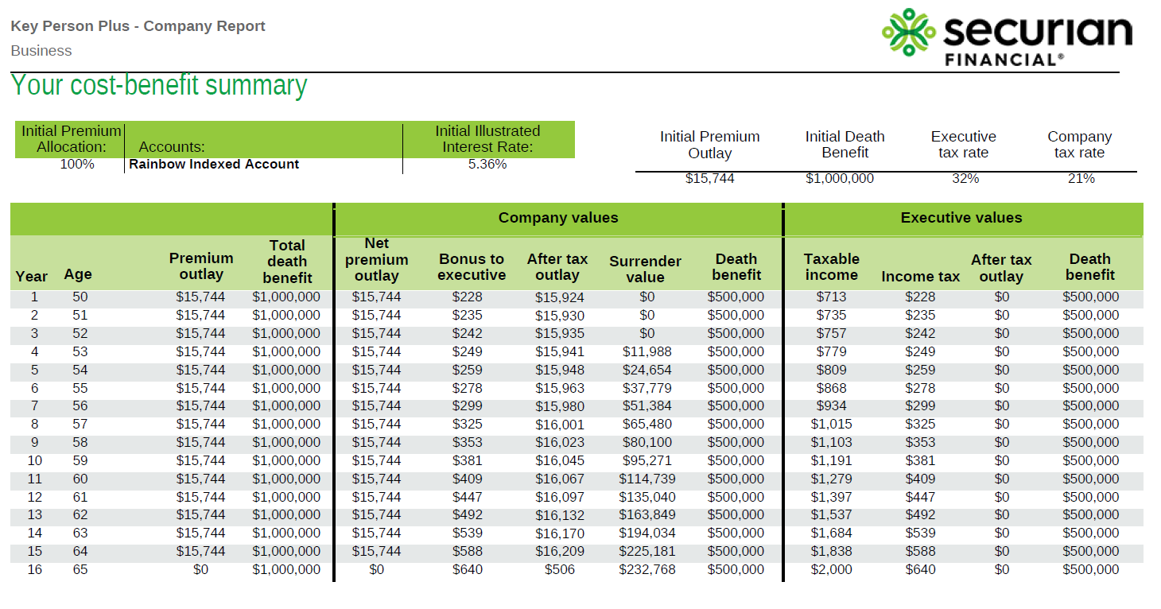
Key person plus
This hypothetical example is for illustrative purposes only.
Notes:
(Case ID: 20241866)
Here we have an example from our illustration software, showing a split-dollar (Key person plus) strategy with a $1M death benefit split between employer and executive. Female, age 50, preferred non-tobacco.
Review details of example.

Slide 28


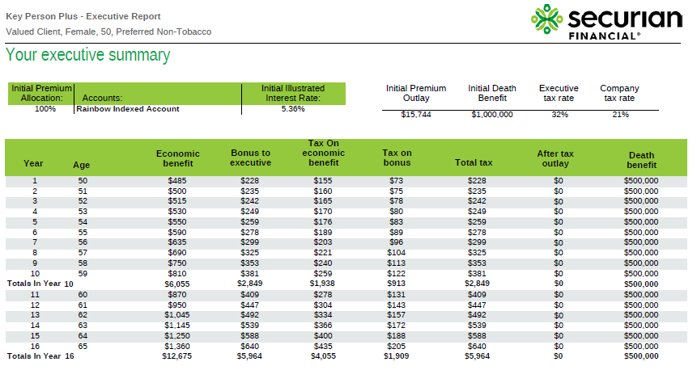
Key person plus
This hypothetical example is for illustrative purposes only.
Notes:
(Case ID: 20241866)
Here I want to highlight that our software will outline not only the strategy, plan, and life insurance illustration for the company/employer, but also for the executive.
(Review examples of illustration/report to show what can be presented)

Slide 29
Employer-financed life insurance
Notes:
Let’s move to employer-financed life insurance
Owner of the policy is the executive (with the obligation to pay back the loan to the business)
Insured of the policy is the executive
Beneficiary of the policy is the executive (with the obligation to pay back the loan to the business)
The opportunity
Business owner(s) wishing to:
• Reward and retain key people for their contribution to the company’s success
• Provide an executive benefit of life insurance for the executive’s dependents
• Provide key-person protection for the business
• Potentially recover costs of the benefit
Solution: employer-financed life insurance
Employer-financed life insurance is a collateral assignment split-dollar executive compensation strategy. A business agrees to make a loan or series of
loans to an executive in order to pay premiums on a permanent life insurance policy. The policy insures the executive’s life and is assigned to the company as collateral for the loan transaction.
Three valuable features
1. Economical death benefit for the executive
2. Business can retain executive with loans for policy premium
3. Business may recover loaned premium when the agreement ends or if the executive dies
Target client
Businesses with the following characteristics:
• Privately held
• Concerned with retaining key executives
• Executives ages 45-60
Employer-financed life insurance may be offered to sales professionals, managers, executives and other highly compensated employees as well as the business owner(s) in some situations.
How it works
• The company loans money to an executive to pay premium on a permanent life insurance policy, which accumulates cash value.
• The executive purchases a policy. Working with a licensed attorney, you establish a split-dollar agreement that collaterally assigns a portion of the death benefit to the company.
• The executive names a beneficiary.
At rollout or at the executive’s death, the company receives a portion of the policy’s cash value equal to the premiums paid, plus interest. The executive or
the executive’s family retains ownership of the policy and may access its cash value as potential supplemental retirement income.
Employer-financed life insurance benefits
Employer
• Employee owns the policy
• Flexible and minimal administrative costs
• Company can select employees it wants to reward
Employee
• Affordable death benefit coverage for employee
• Death benefit paid to insured’s beneficiary income tax-free
• Ability to exclude death benefit from estate with proper planning
Employer-financed life insurance considerations
Employer
• No income tax deduction for premium payments
• Special issues for flow-through tax entities (LLCs, partnerships, etc.)
• Costs may not be fully recovered
• Attorney fees for drafting agreement
• Any interest paid to company for loaned premium is taxable to company
Employee
• Taxed annually; method depends on type of taxation option chosen (loan or economic benefit)
• Must be acceptable underwriting risk
• Death proceeds may be included in estate
• Subject to employer’s creditors

Slide 30
Nonqualified deferred compensation (NQDC)
Notes:
The final grouping of executive compensation strategies is NQDC.

Slide 31
What is NQDC?
Notes:
What is NQDC?
Key characteristics of an NQDC strategy:
• Reduces key employees’ current taxable income in exchange for a promise to pay benefits sometime in the future (typically retirement)
• Effective when a company offers a qualified plan but key employees are limited in their contributions
• May provide for golden handcuffs, allowing a company to recover all or a portion of employer’s contributions to the plan if employee leaves before a particular date
• Companies can select specific key employees to whom it offers the plan
• Commonly funded with permanent life insurance: Employer owns, is beneficiary of and makes annual premium payments on life insurance policy on employee
For all of the NQDC arrangements:
The owner of the life insurance policy is the business
The insured of the policy is the employee
The beneficiary of the policy is the business

Slide 32
Bonus Deferral
During working years
Retirement
Notes:
Let’s go deeper into each of the three types of NQDC arrangements.
The Bonus Deferral is the first one.
1. Company and key employee implement an agreement, drafted by a licensed attorney, specifying (among other provisions):
• The time at which the key employee can elect to defer compensation.
• The circumstances under which deferred compensation can be paid to the key executive (i.e., separation of service, death, disability, financial emergency, change of
control of employer or a specified date).
• The executive’s deferred salary.
• The employer’s contribution.
• A vesting schedule, if desired.
• Notice and consent requirements.
• Designated beneficiaries.
2. Company determines how the plan will be funded:
• The plan must be unfunded in order to obtain the preferable tax and ERISA treatment.
• The company should consider an informal funding method to meet its obligations under the plan.
• As an informal funding vehicle, permanent life insurance offers tax-deferred growth potential and tax-advantaged access to policy values:
Company is owner and beneficiary of the policy. The employee is typically the insured but has no rights or ownership in the life insurance policy.
Company may choose to provide NQDC retirement benefits on a tax-advantaged basis through policy loans and withdrawals.
If the company chooses to pay retirement benefits using existing funds and hold the policy until the insured dies, internal gains are not taxed.

Slide 33
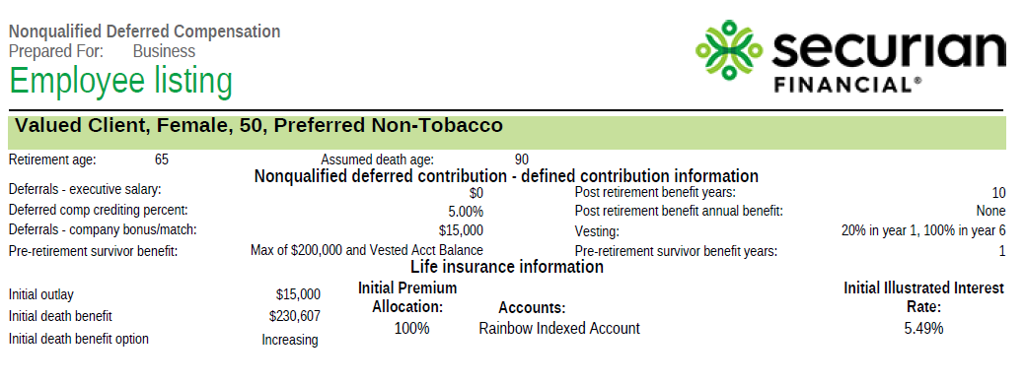
Executive details and deferral
This hypothetical example is for illustrative purposes only.
Notes:
(Case ID: 20241716)
Here we have an example output of the illustration details for the NQDC- bonus deferral.
Assuming the executive is a female, age 50, preferred non-tobacco rating.
The company is going to defer, on behalf of the executive, an annual bonus of $15,000, for 15 years. Upon retirement at age 65, she will receive a benefit for 10 years.

Slide 34
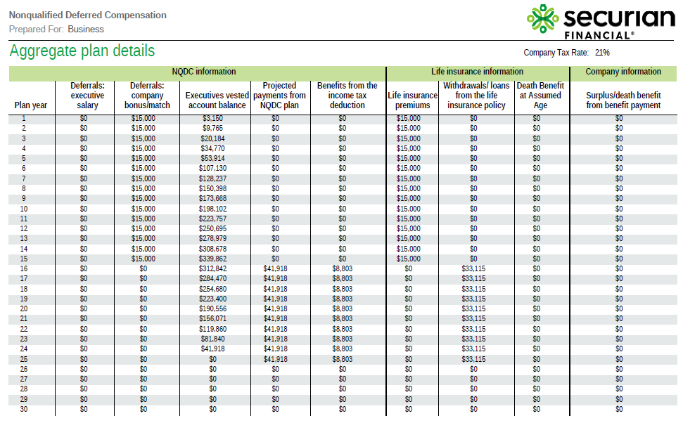
This hypothetical example is for illustrative purposes only.
Notes:
(Case ID: 20241716)
Here we have the output example of the plan.
(Review details of hypothetical example)

Slide 35

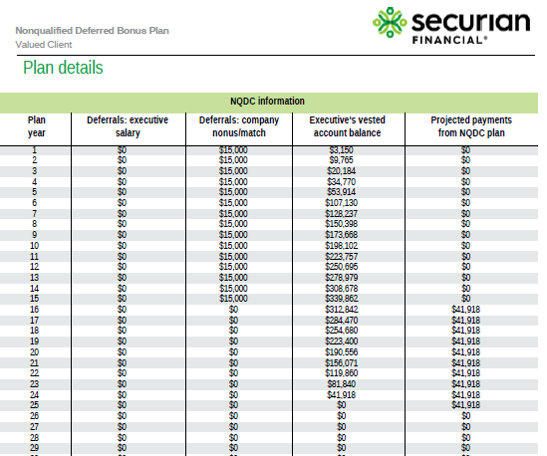
Notes:
(Case ID: 20241716)
The illustration system will not only show the output of the plan (here on the right for the employee), as well as the life insurance illustration, but outline the strategy for both the employer and employee (as show here on the left).
(Discuss details on slide).

Slide 36
Employer Match
During working years
Retirement
Notes:
Employer Match is different because the Employer matches the employee‘s contribution
Here’s how it works:
Plan is drafted outlining contribution amounts, match, vesting schedule, distribution, etc.
Employee defers a portion of income or a bonus
Employer provides a percentage match of employee’s deferral
Employer purchases permanent life insurance to informally fund the nonqualified liability
At employee’s retirement, employer pays an annual amount to employee
Employer may then deduct amount paid, and employee must report as taxable income

Slide 37
Supplemental Executive Retirement Plan (SERP)
During working years
Retirement
Notes:
SERP is different because the funding comes only from the business
Here is how it works:
Employer agrees to pay employee additional benefits in the form of a future retirement payment based on salary and years of service
Employee receives benefits upon retiring and satisfying vesting schedule
Employer may then deduct amounts paid, and employee must report as taxable income

Slide 38
Protection SERP
Split dollar – during working years
NQDC – at retirement
Notes:
Okay, we are almost done. One more strategy to discuss Protection SERP
Protection SERP combines the benefits of key person plus (endorsement split dollar) during the executive’s working years and switching to a SERP

Slide 39
Protection SERP
During working years
Retirement
Notes:
Here is how it works:
1. Company and key employee implement an endorsement split-dollar agreement, drafted by a licensed attorney, specifying:
The plan type — defined contribution or defined benefit — details of employer contributions, a method of crediting earnings and a vesting schedule if desired.
The benefit that will be paid to the executive at retirement.
2. Company determines how the plan will be funded:
The plan must be unfunded in order to obtain the preferable tax and ERISA treatment.
The company should consider an informal funding method to meet its obligations under the plan.
As an informal funding vehicle, permanent life insurance offers tax-deferred growth potential and tax-advantaged access to policy values:
Company owns and pays premiums on a life insurance policy insuring the key executive’s life. It also endorses a portion of the death benefit to the executive as a pre-retirement survivor benefit for the executive’s beneficiaries.
Key executive pays tax on the premium or contributes an amount equal to the reportable economic benefit for the amount of premium. The reportable economic benefit is a calculation of the tax obligation for the death benefit provided in a split dollar arrangement. It’s calculated using term life insurance rates.
If the executive dies while employed by the company, the company receives a portion of the death benefit to recover its costs; the executive’s beneficiaries receive the balance.
When the executive retires, the split-dollar agreement terminates. The company may use the policy cash value to pay supplemental retirement income.

Slide 40
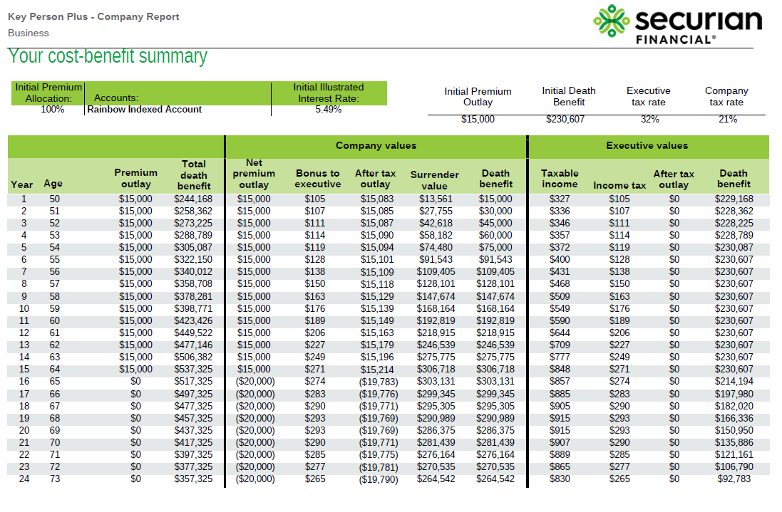
This hypothetical example is for illustrative purposes only.
Notes:
(Case ID: 20356321)
Here we have the output example of the plan, where we have our 50 year old female executive, preferred non-tobacco, where there will be a death benefit for the executive’s family during working years, and key person protection for the company. At retirement at age 65, the executive will receive an annual deferred compensation of $20k per year, and the company will have cost recovery in the form of the death benefit.
(Review details of hypothetical example)
NOTE: illustration software will outline plan details (along with the required life insurance illustration) for both the executive and the employer/company.

Slide 41
Any questions?
Notes:
Any questions?

Slide 42
Please keep in mind that the primary reason to purchase a life insurance product is the death benefit.
Life insurance products contain fees, such as mortality and expense charges (which may increase over time), and may contain restrictions, such as surrender periods. Variable life insurance products contain fees, such as mortality and expense charges, and may contain restrictions, such as surrender periods. There may also be underlying fund charges and expenses, and additional charges for riders that customize a policy to fit individual needs. Charges and expenses may increase over time. The variable investment options are subject to market risk, including loss of principal.
Depending upon actual policy experience, the Owner may need to increase premium payments to keep the policy in force.
The policy design chosen may impact the tax status of the policy. If too much premium is paid, the policy could become a modified endowment contract (MEC). Distributions from a MEC may be taxable and if the taxpayer is under the age of 59 ½ may also be subject to an additional 10% penalty tax.
Policy loans and withdrawals may create an adverse tax result in the event of lapse or policy surrender and will reduce both the surrender value and death benefit. Withdrawals may be subject to taxation within the first 15 years of the contract. Clients should consult their tax advisor when considering taking a policy loan or withdrawal.
Due to uncertainty in the tax law, chronic illness benefits paid from a life insurance contract may be taxable. Please ensure that your clients consult a tax advisor regarding chronic illness care benefit payments from a life insurance contract. Due to uncertainty in the law, long-term care benefits taken in the form of policy loans or withdrawals from a life insurance contract may be taxable. Please ensure your clients consult a tax advisor regarding long term care benefit payments from a life insurance contract.
Additional agreements may be available. Agreements may be subject to additional costs and restrictions. Agreements may not be available in all states or may exist under a different name in various states and may not be available in combination with other agreements.
Other than contribution limits or tax treatment, several other factors should be considered before purchasing any of these products. These include investment objectives, costs and expenses, liquidity, safety, fluctuation of principal or return, credit rates, rider availability, surrender periods and other product/ investment characteristics.
This material may contain a general analysis of federal tax issues. It is not intended for, nor can it be used by any taxpayer for the purpose of avoiding federal tax penalties. This information is provided to support the promotion or marketing of ideas that may benefit a taxpayer. Taxpayers should seek the advice of their own tax and legal advisors regarding any tax and legal issues applicable to their specific circumstances.
These are general marketing materials and, accordingly, should not be considered investment advice or a recommendation that any particular product or feature is appropriate or suitable for any particular individual. These materials are based on hypothetical scenarios and are not designed for any particular individual or group of individuals (for example, any demographic group by age or occupation). The materials were prepared for financial professionals who are experienced in investment and/or insurance matters. As a result, they should not be reviewed or relied on by any other persons. Securian Financial Group, and its subsidiaries, have a financial interest in the sale of their products.
Insurance products are issued by Minnesota Life Insurance Company in all states except New York. In New York, products are issued by Securian Life Insurance Company, a New York authorized insurer. Minnesota Life is not an authorized New York insurer and does not do insurance business in New York. Both companies are headquartered in St. Paul, MN. Product availability and features may vary by state. Each insurer is solely responsible for the financial obligations under the policies or contracts it issues. Variable products are distributed by Securian Financial Services, Inc., member FINRA. 400 Robert Street North, Saint Paul, MN 55101.
Securian Financial is the marketing name for Securian Financial Group, Inc., and its subsidiaries. Minnesota Life Insurance Company and Securian Life Insurance Company are subsidiaries of Securian Financial Group, Inc.
For financial professional use only. Not for use with the public. This material may not be reproduced in any way where it would be accessible to the general public.
Securian Financial Group, Inc.
securian.com
400 Robert Street North, St. Paul, MN 55101-2098
©2022 Securian Financial Group, Inc. All rights reserved.
BOLDEXCOMPPPT DOFU 4-2022
2087338

